Slide 1
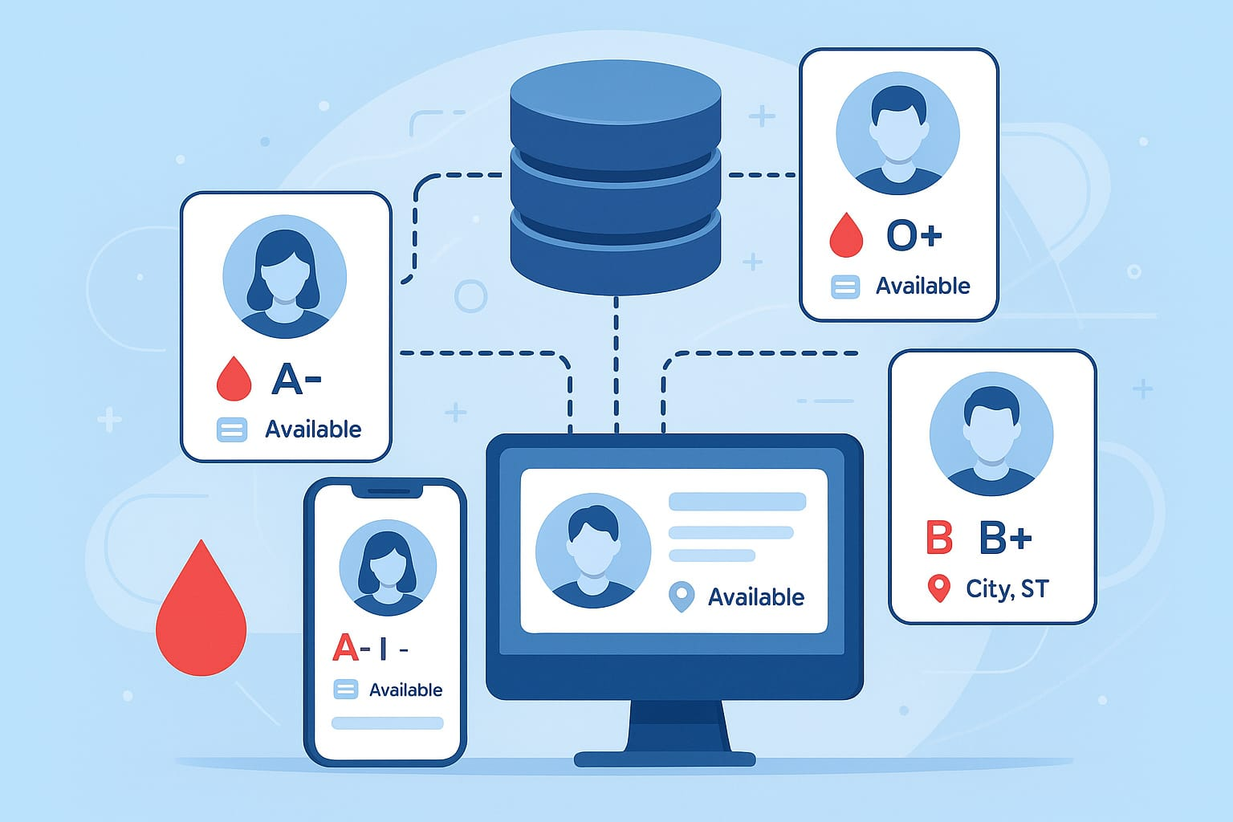

Slide 4
ABSTRACT
Blood donation is a critical component of healthcare, saving countless lives each year. However, many regions, including Ghana, face chronic shortages of blood supply, often resulting in lifethreatening delays for patients in need. Traditional blood donation methods are plagued with inefficiencies, causing delays in matching donors with recipients, and hindered by cumbersome paperwork that discourages potential donors. To address these challenges, this paper introduces an Online Blood Donation System, which offers an accessible, efficient, and secure platform for connecting blood donors with those in need. The project encompasses a comprehensive study, employing the Agile methodology, HTML, CSS, JavaScript, PHP, and MySQL, to design and develop the system. The system's objectives encompass facilitating blood donation, enhancing efficiency, increasing donor participation, ensuring data security, promoting awareness, and overall healthcare system improvement. This project aims to contribute to the healthcare sector by providing an innovative solution to blood donation challenges, ultimately saving lives and improving healthcare efficiency.

Slide 5
DATABASE-Driven Blood Donor Directory Study & Design.

